Slide 1
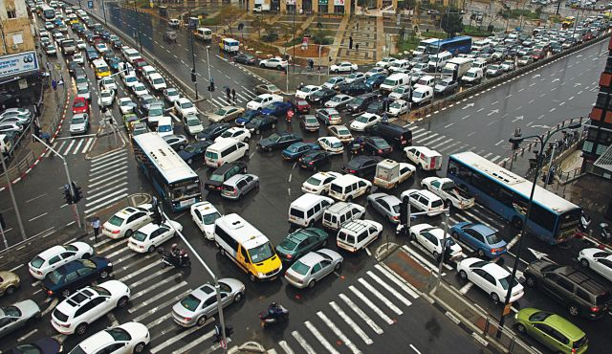
A Non-homogeneous Time Mixed Integer LP Formulation for Traffic Signal Control
Iain Guilliard, Scott Sanner, Felipe Trevizan, Brian Williams
Notes:
1. Title Slide: I'm going to talk about recent progress in how to globally optimize traffic signals using MILPS.

Slide 2
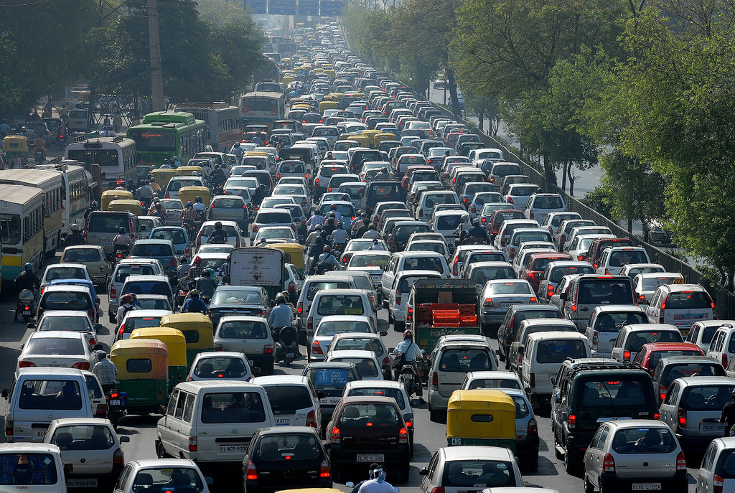
Motivation
Notes:
Fixed plan:
- not adaptive to changes in traffic
- fixed objective: worst case or average, etc
Adaptive:
- old - from 1960's
- reactive rather than predictive

Slide 3
Control methods
Suboptimal
Fixed Time Control
Adaptive Control: e.g. SCOOT and SCATS
Good: scalable
Bad: no performance guarantee
Locally optimal:
e.g. SURTRAC
Good: decentralized control
Bad: myopic
Globally optimal
e.g. CTM, LTM
Good: best solution possible
Bad: scalability
Notes:
3. Fixed-time: in practice, different plans for different times of day + actuation.

Slide 4
In this work
We present the Queue Transmission Model that:
Is globally optimal
We take advantage of the new developments in MILP solvers
Allows arbitrary topology
Grids and asymmetric intersections
Scales to many intersections
We use non-homogenous time steps to decrease the size of the problem

Slide 5
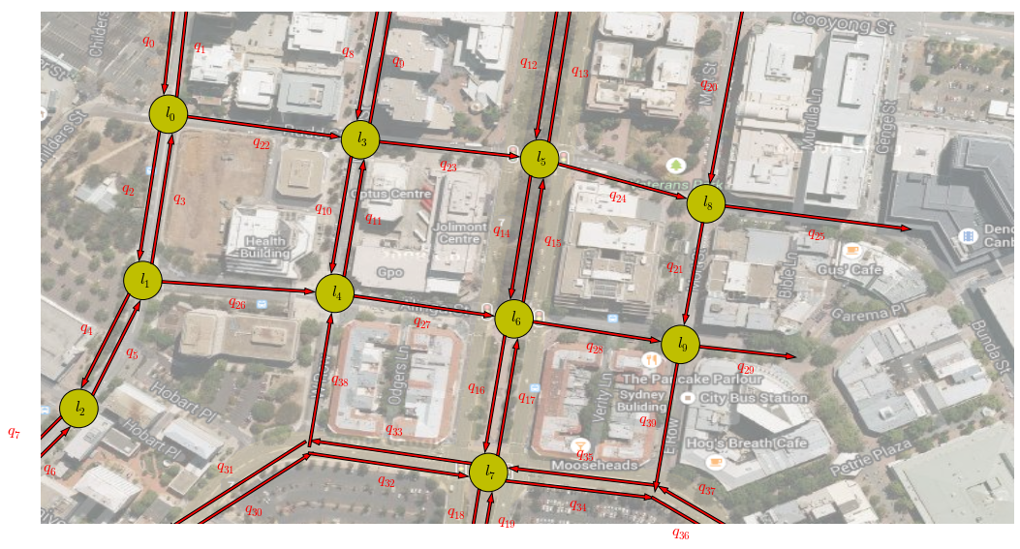
Homogeneous vs Non-Homogeneous
Time discretization:
Homogenous: uniform
Non-homogenous: arbitrary
Advantages of non-homogeneous:
Increase spatial horizon
Offers fidelity trade off
Non-Homogeneous
Homogeneous

Slide 6
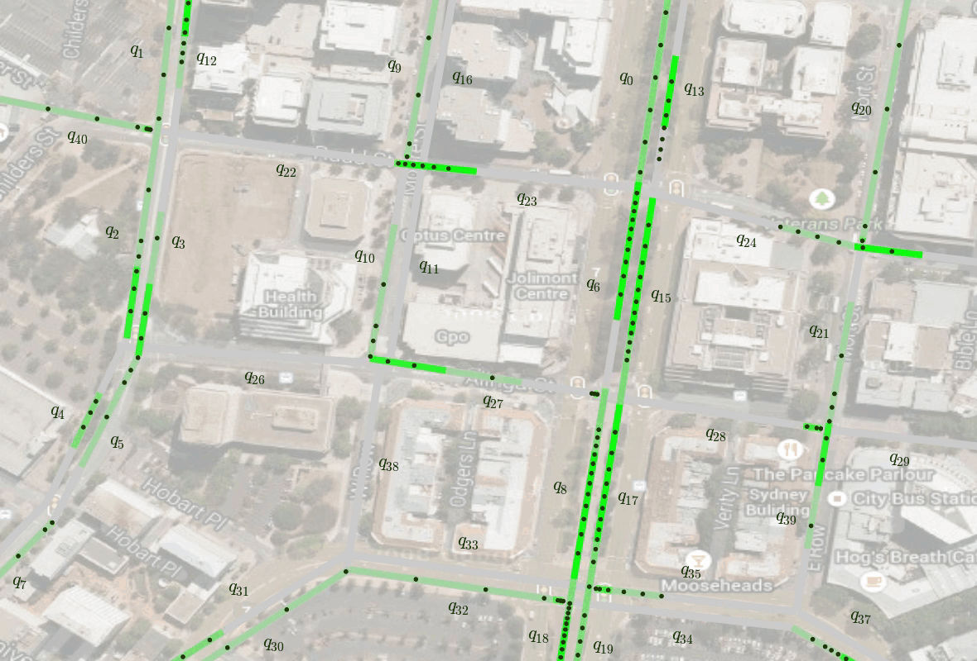
QTM Example – Flow with fixed control

Slide 7
QTM Example – Queuing Behavior

Slide 8
QTM Example – Platoons

Slide 9
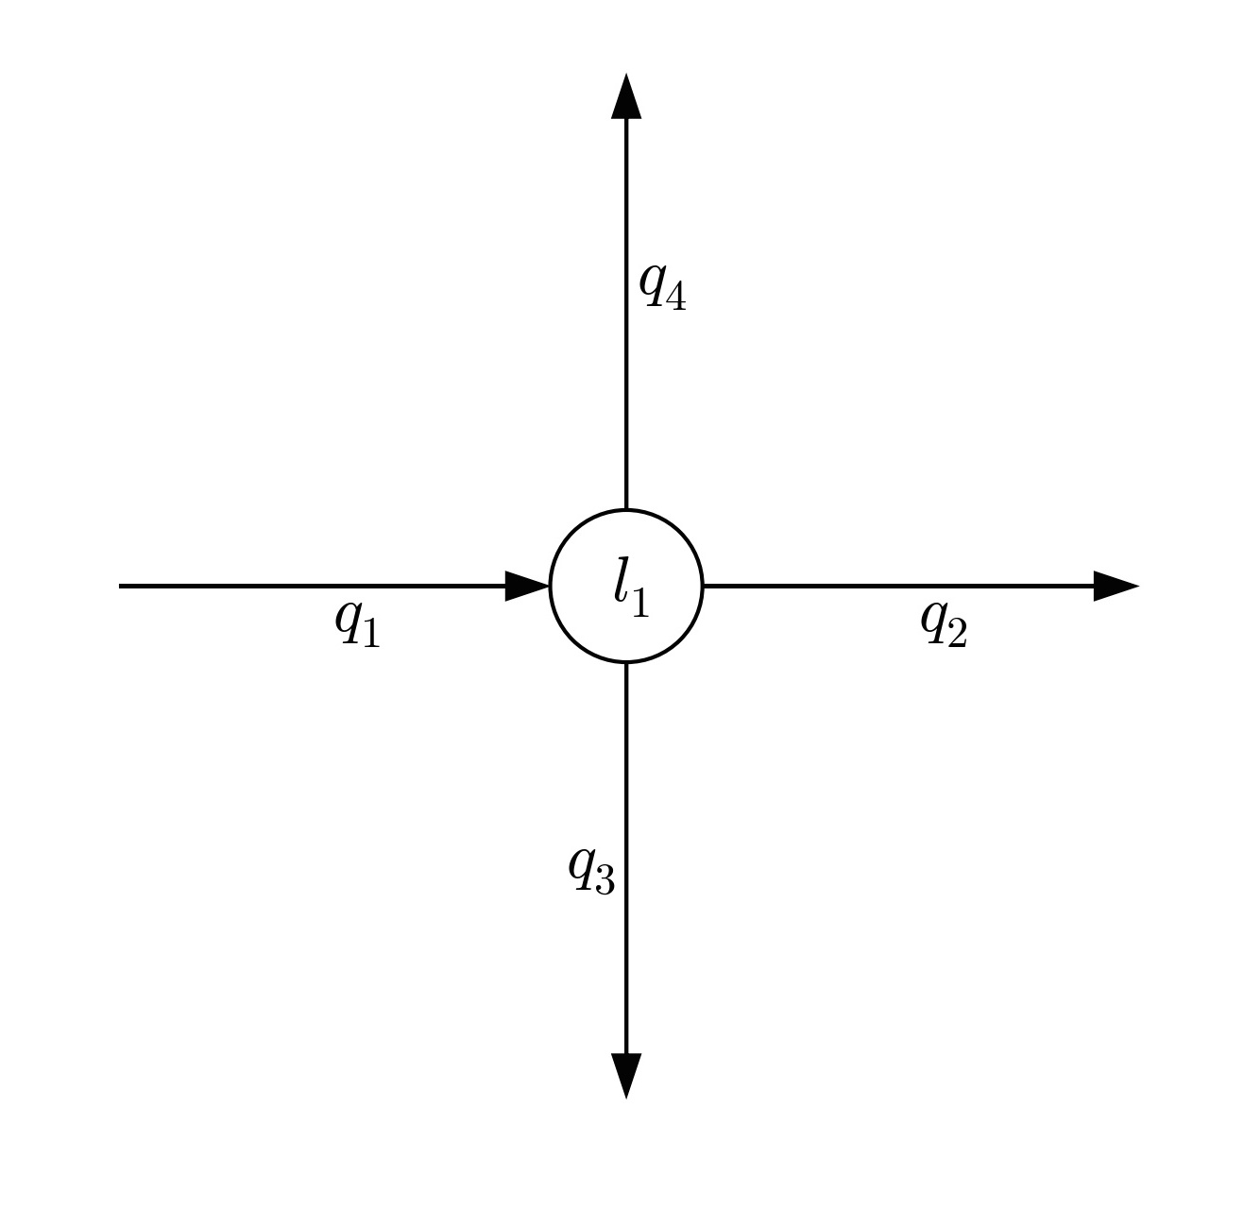
QTM – Variables and Parameters

Slide 10
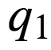
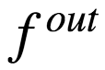
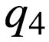
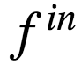
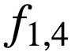
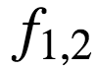
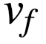
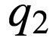
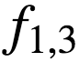
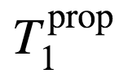
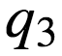
QTM – Variables and Parameters
F
I
F
O

Slide 11
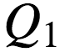
QTM – Variables and Parameters
FIFO

Slide 12
QTM – Variables and Parameters

Slide 13
QTM - Dynamics
Link
traffic state
v_{f}
platoon
queue at light
QTM
CTM
3 cells
c₁
c₂
c₃
CTM
9 cells
c₁
c₂
c₃
c₄
c₅
c₆
c₇
c₈
c₉

Slide 14
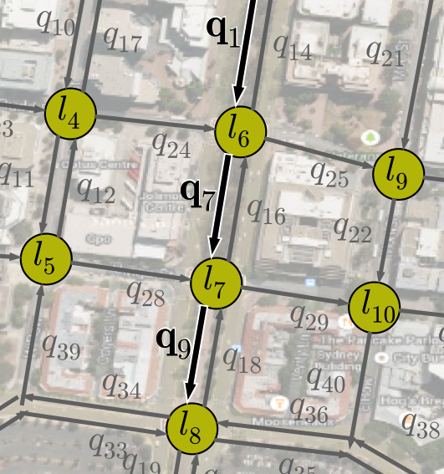
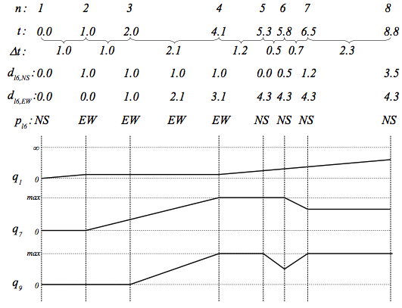
QTM – Non-homogeneous time steps

Slide 15
QTM – Non-homogeneous time steps

Slide 16
QTM – Non-homogeneous time steps

Slide 17
QTM – Non-homogeneous time steps

Slide 18
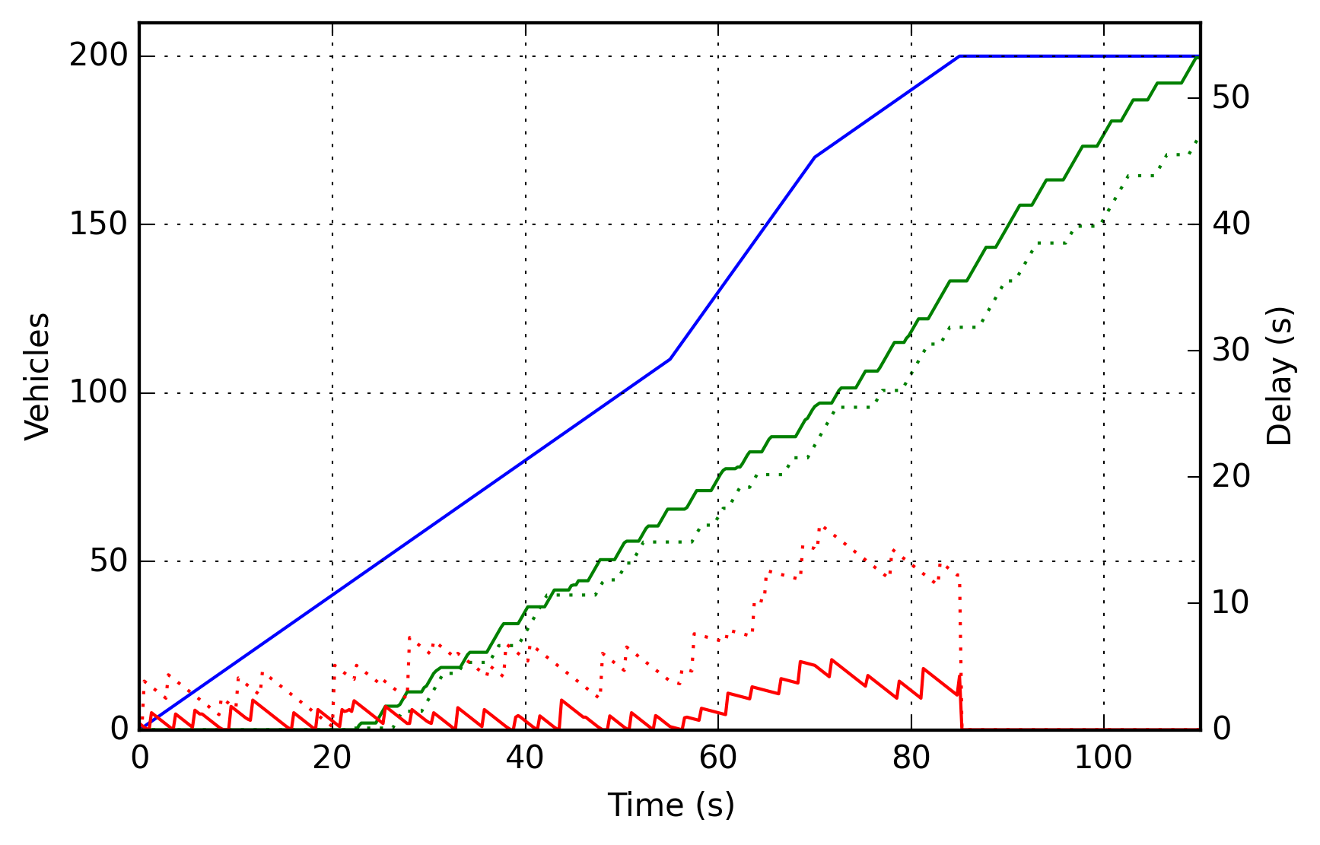
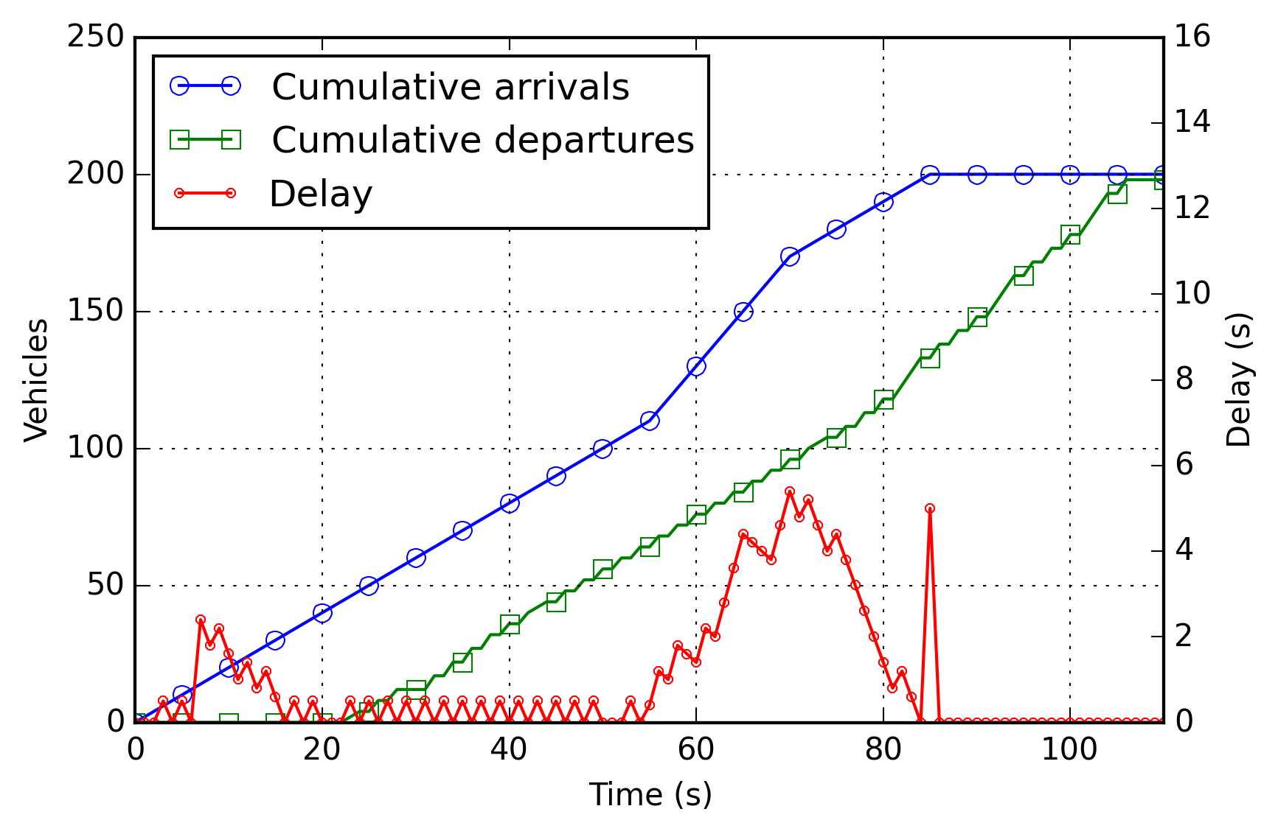
Objective Function
Travel Time
Out flow
In flow
Delay

Slide 19
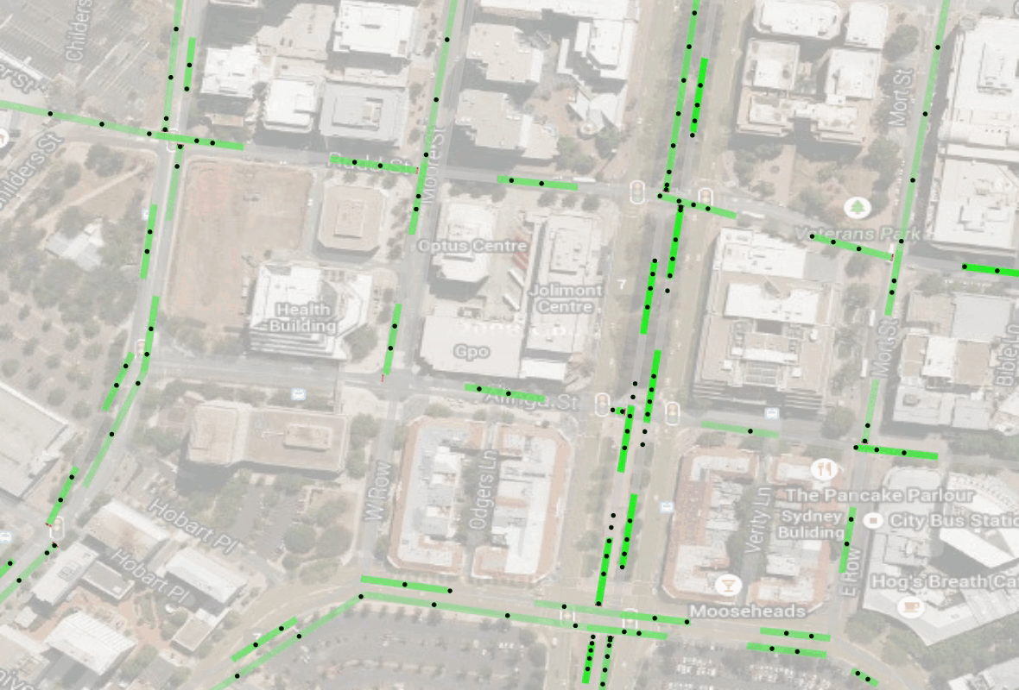
QTM Example: with optimized control

Slide 20
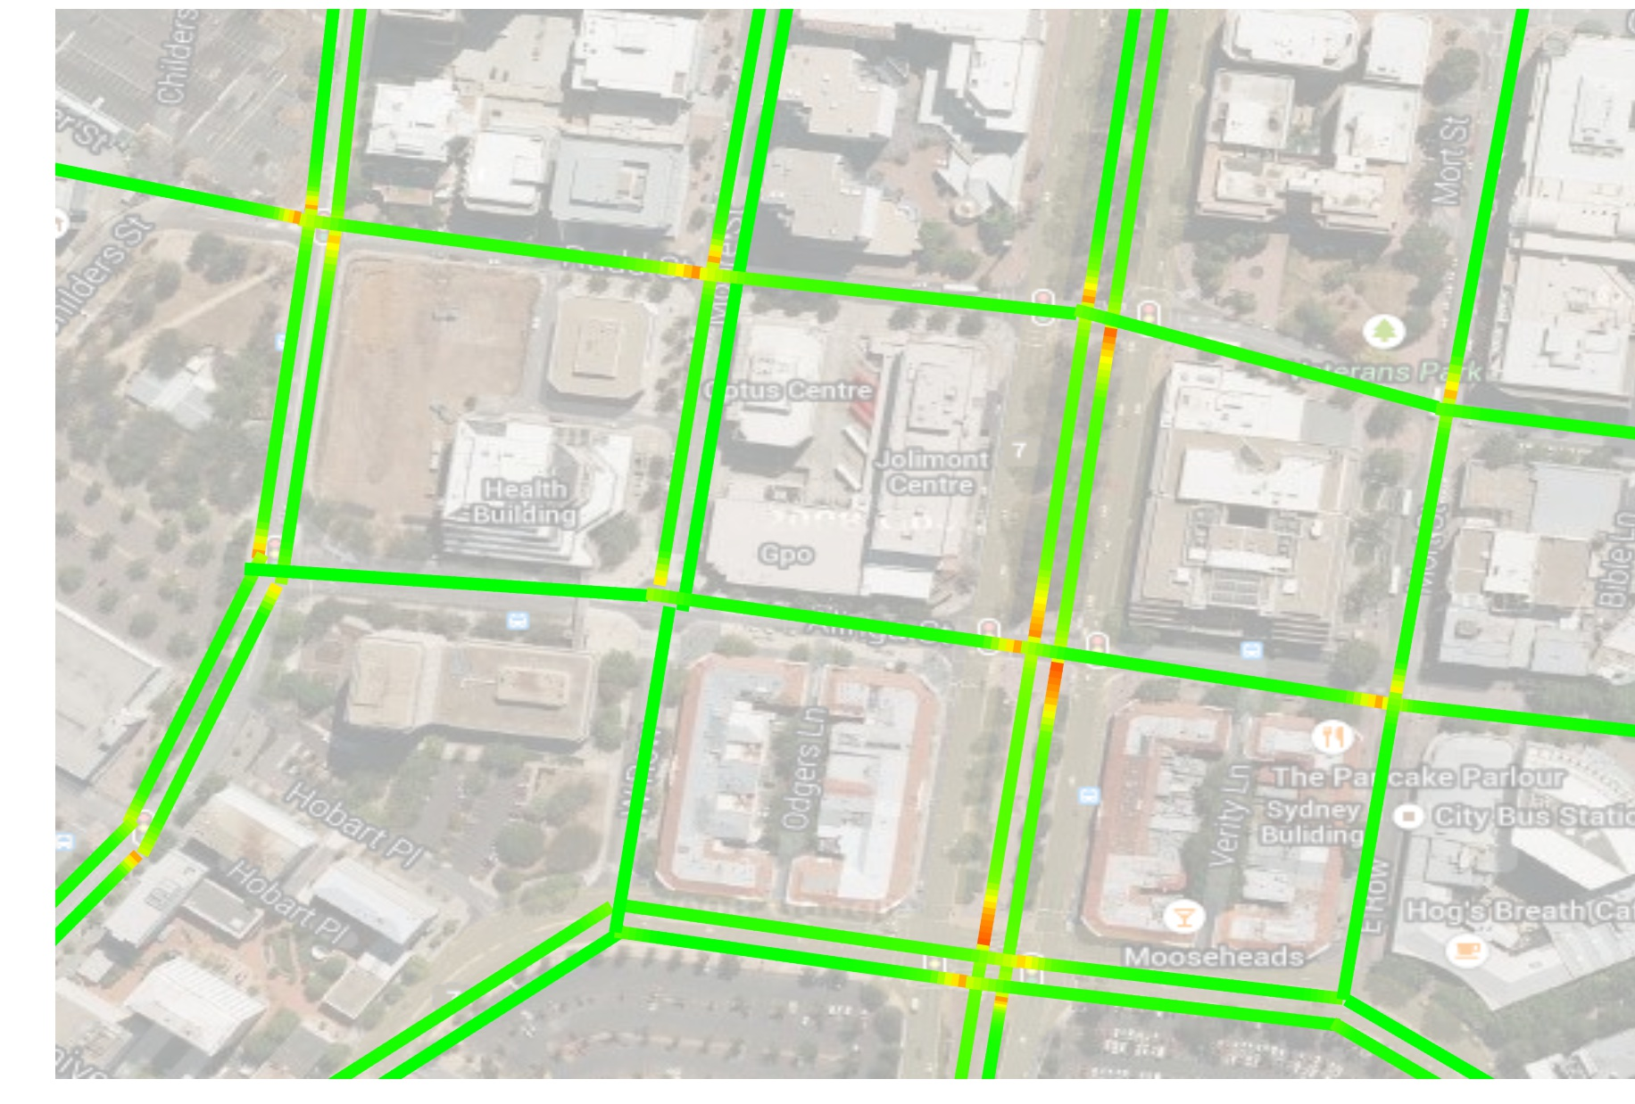
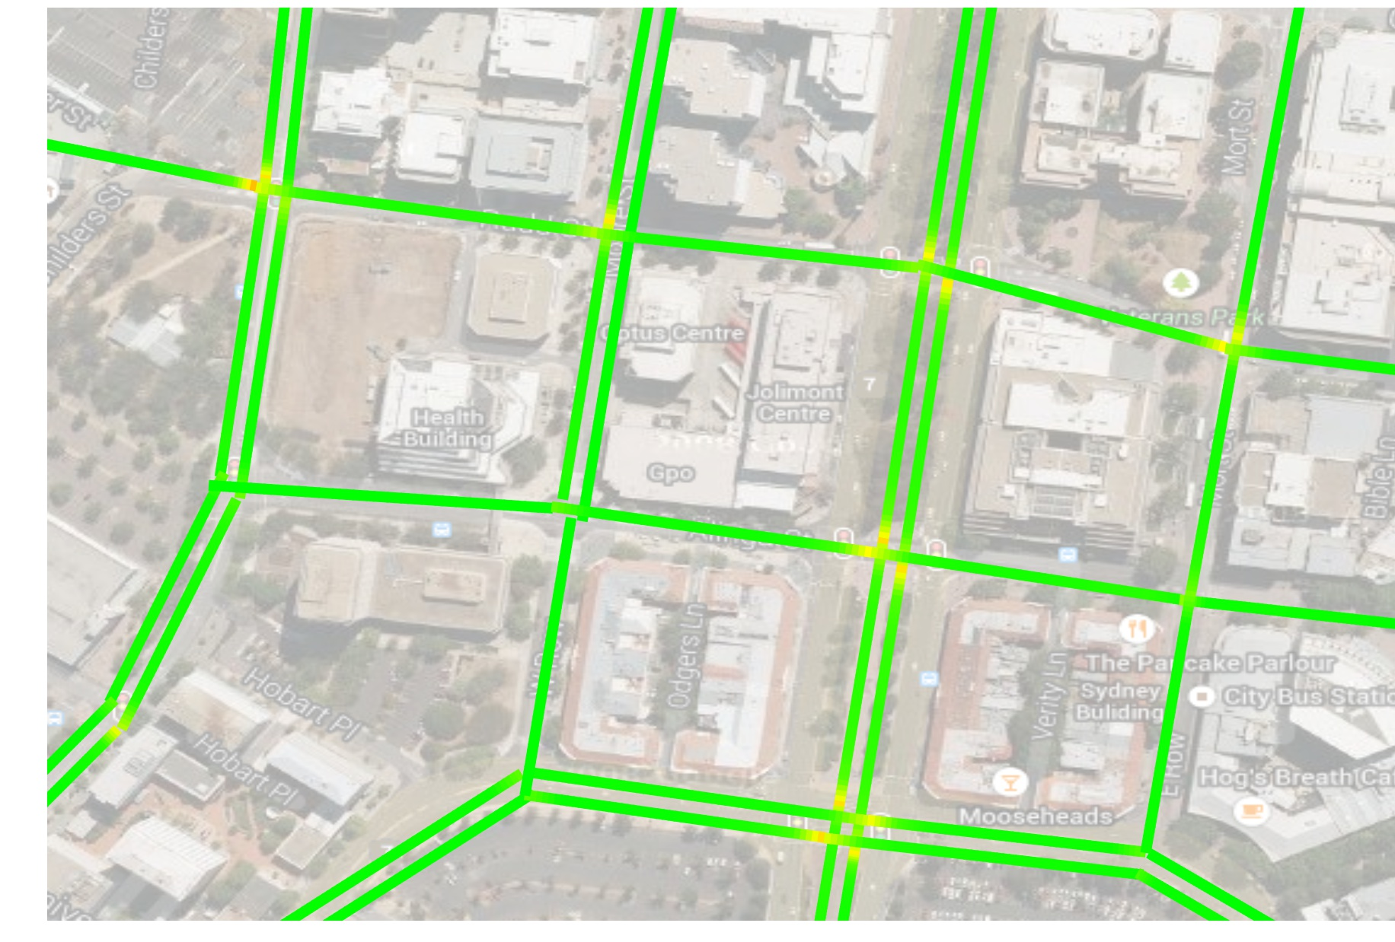
Example: Delay Map, fixed vs optimized
Fixed
QTM Optimized

Slide 21
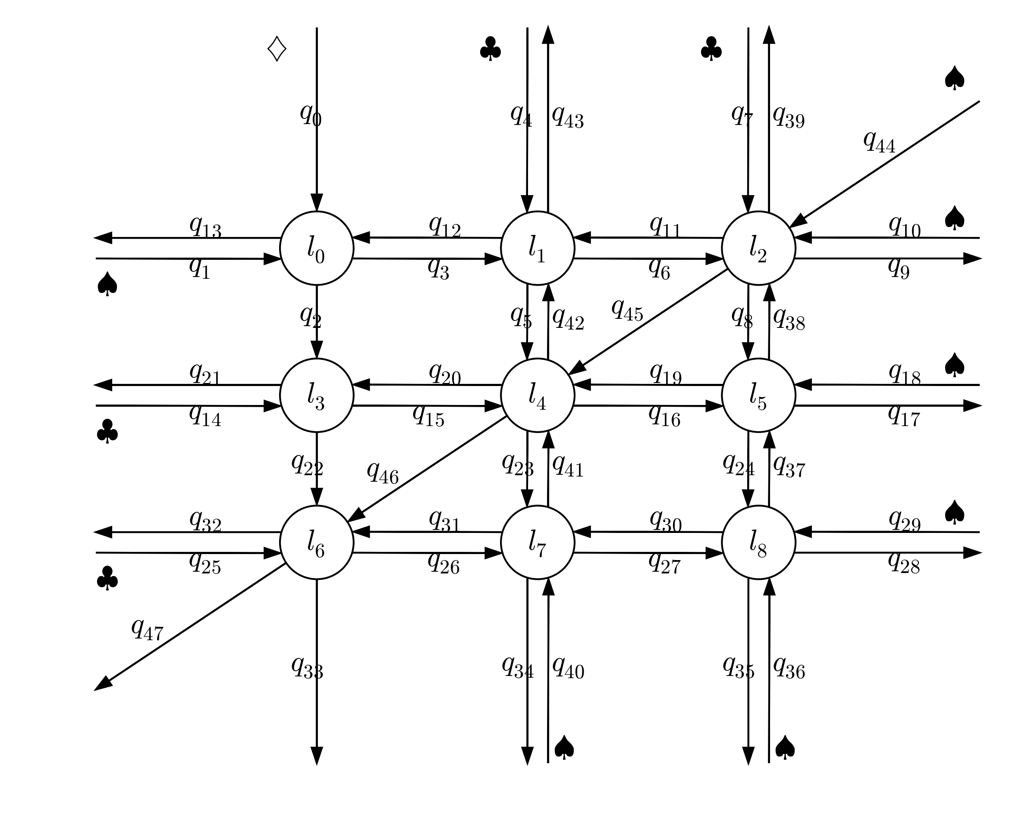
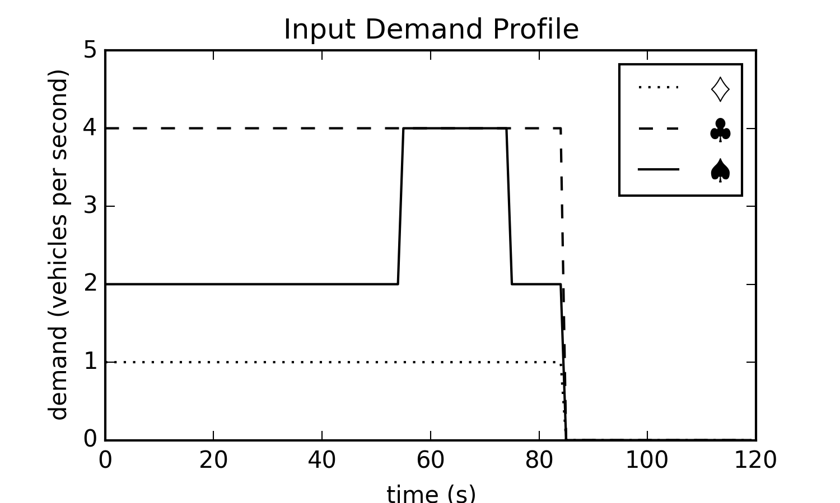
Experiments - Networks

Slide 22
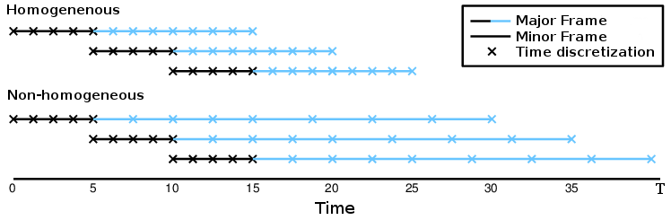
Experiments – Receding Horizon Control

Slide 23
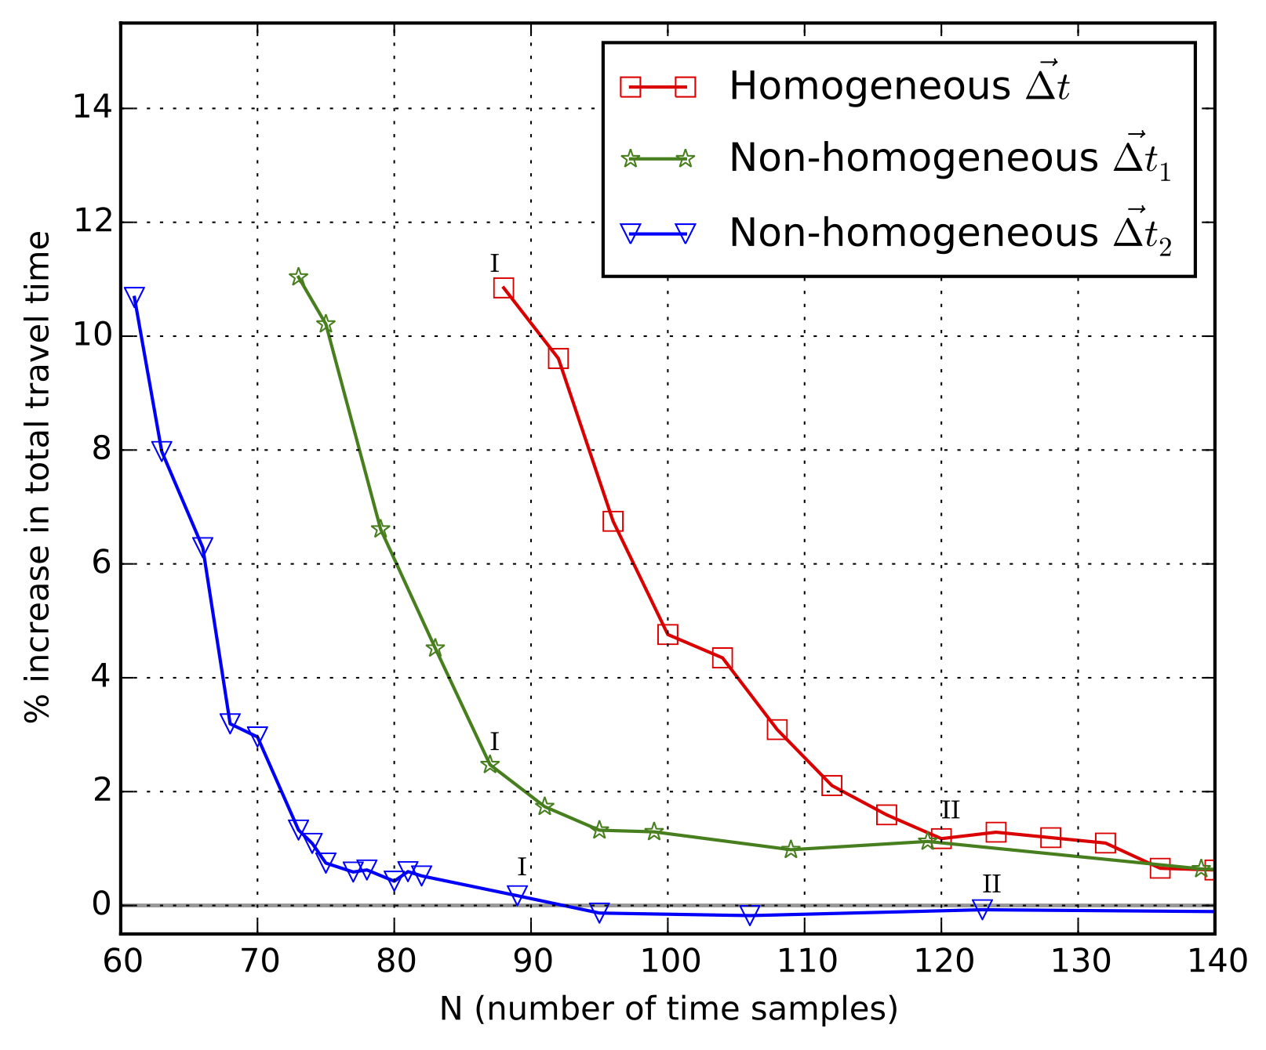
Results - Convergence
Increasing travel time
Non-
Homogeneous
Homogeneous
Non-
Homogeneous
Time samples / planning horizon

Slide 24
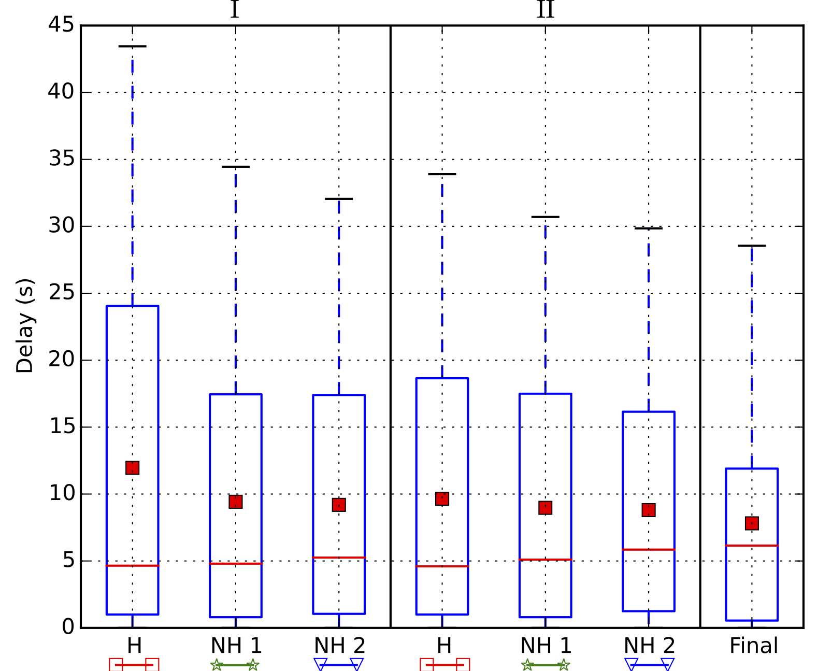
Results - Quality
F
Increasing travel time
Time samples / planning horizon

Slide 25
Conclusion
Presented Queue Transmission Model (QTM)
Globally optimal
Allows arbitrary topology
Scales to many intersections
Main insight: non-homogenous time discretization
Compared to homogeneous solution:
Faster convergence
Same or better solution quality
Notes:
Compare optimized plans with SCATS/SCOOT to see if there is a better heuristic

Slide 26
Future Work
Close the loop
Learn parameters from data
Add Extensions:
Light rail
Uncontrolled intersections
Code on Github:
github.com/iainguilliard/QTM_Traffic_Model
Notes:
Compare optimized plans with SCATS/SCOOT to see if there is a better heuristic

Slide 27
Thank you!
Questions?

Slide 29
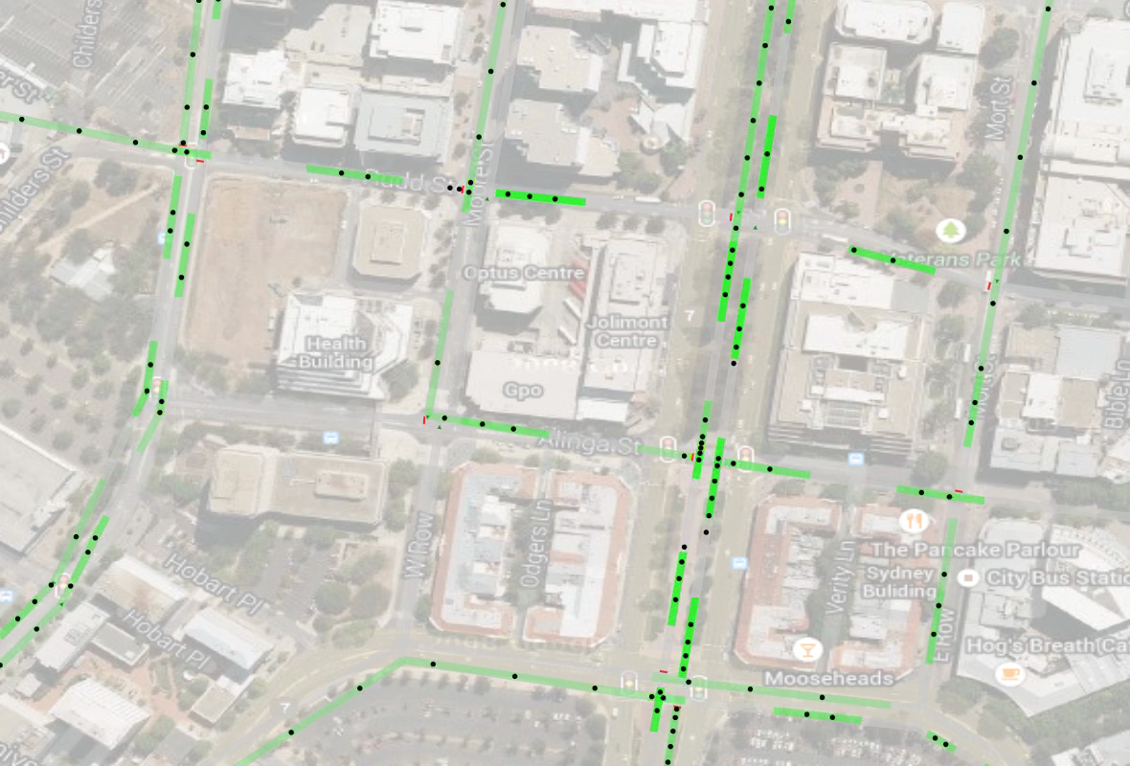
Example: QTM optimized control

Slide 30
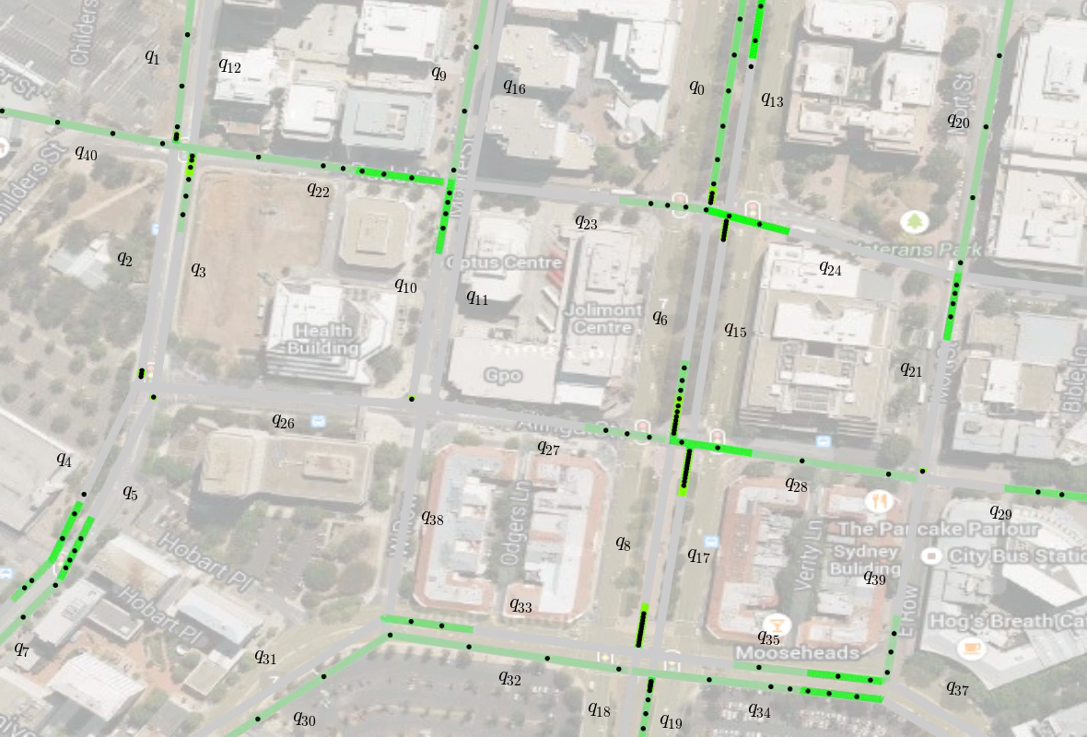
Example: Fixed Control with QTM flow

Slide 31
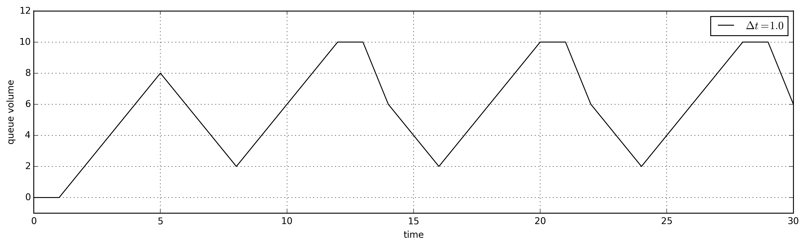
Integration V(x,y)

Slide 32
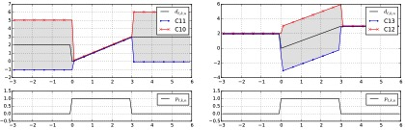
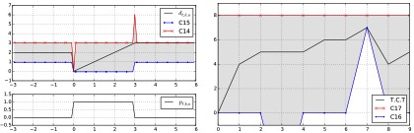
Phase Duration Control
Ramp
Hold
Reset
Cycle time

Slide 33
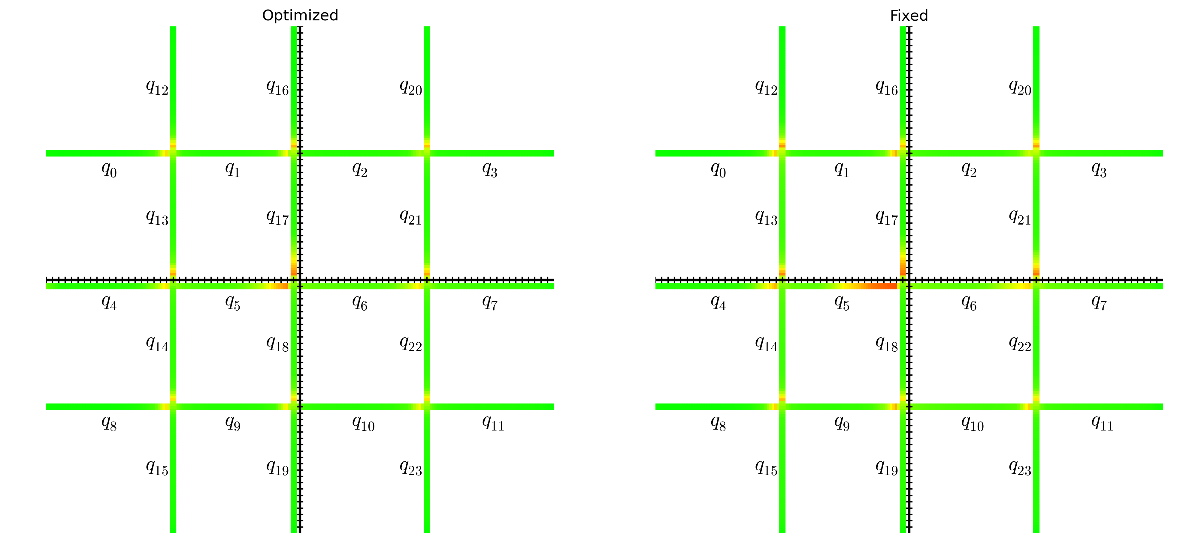
Delay Heat Map 3400 vph

Slide 34
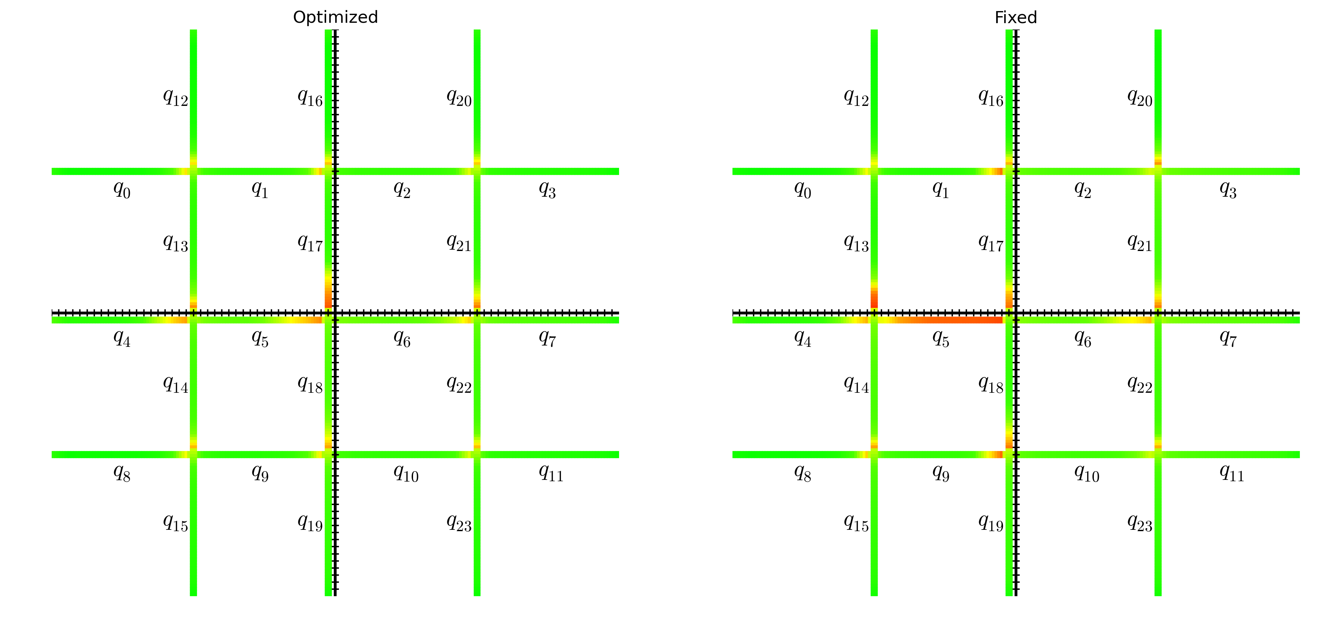
Delay Heat Map 4300 vph

